Slide 1
Retail Sales Exploratory Data Analysis
Oasis Infobyte — Data Analytics Internship
Intern Name: Nandini Dolas
Task: Level 1 — Task 1
Tools Used: Python, Pandas, Matplotlib, Seaborn

Slide 2
Project Objective & Dataset
Objective
Analyze retail sales data to identify sales trends and customer purchasing patterns.
Compare revenue across product categories.
Generate insights to support business decisions.
Dataset Overview
Dataset: retail_sales_dataset.csv
Total Records: 1,000 transactions
Total Columns: 9
Tools Used: Python, Pandas, Matplotlib, Seaborn
Analysis Performed
Data cleaning and exploration
Monthly and quarterly sales analysis
Customer demographics analysis
Product category revenue comparison
Correlation analysis

Slide 3
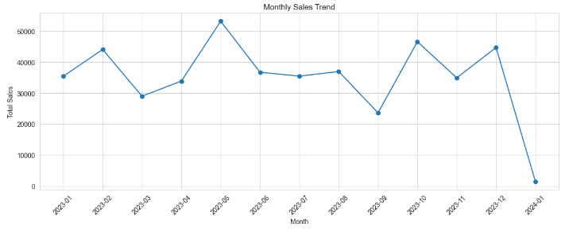
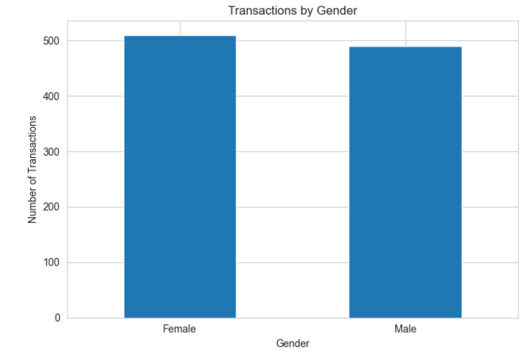
Data Analysis &
Visualizations
1. Sales Trends
Analyzed monthly and quarterly sales.
Identified periods with higher and lower sales.
2. Customer Analysis
Compared transactions by gender.
Explored customer age patterns.

Slide 4
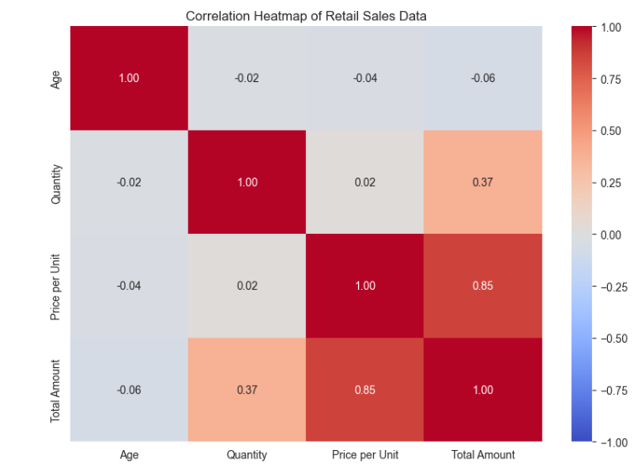
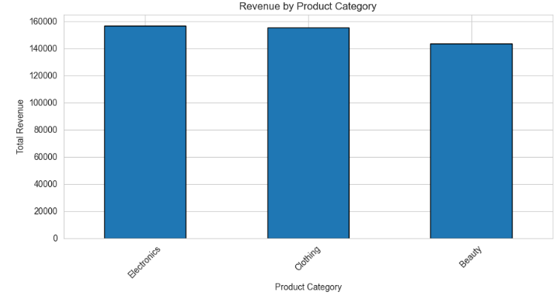
3. Product Category Analysis
Compared revenue from Electronics, Clothing, and Beauty.
4. Statistical Analysis
Examined relationships between price, quantity, age, and total
amount.
Visualizations Created
Monthly and quarterly sales charts
Gender and age analysis
Category revenue chart
Correlation heatmap
Transaction amount histogram

Slide 5
Key Findings
Sales Trends
  Highest Monthly Sales:- May 2023 - 53150
  Highest Quarterly Sales:- 2023Q4 - 126190
Customer Insights
  Female - 510
  Male - 490
Category Revenue
  Electronics - 156905
  Clothing - 155580
  Beauty - 143515
Key Statistical Insights
  Average Transaction amount: ₹456
  Price pre Unit and total amount correlation:0.85
Overall Insight: Electronics generated the highest revenue, while sales trends and customer purchasing patterns can help guide business decisions.

Slide 6
Conclusion
Performed the analysis of 1,000 transactions in Python.
Found out monthly and quarterly sales patterns.
Compared customer demographics and revenues of various products.
Made use of visual data for deriving insights about business.
Conclusion: Insights obtained from analysis will be helpful in making good sales, inventory, and marketing decisions.

Slide 7
THANK YOU!
Retail Sales Exploratory Data Analysis
Oasis Infobyte — Data Analytics Internship

